Slide 1


How to really use ChatGPT Plus Plugins

Slide 2


Slide 3

“A computer would deserve to be called intelligent if it could deceive a human into believing that it was human.”
- Alan Turing, Computing Machinery and Intelligence (1950)

Slide 4
Why ChatGPT Plus?
Supreme Knowledge for $20 / Month

Slide 5
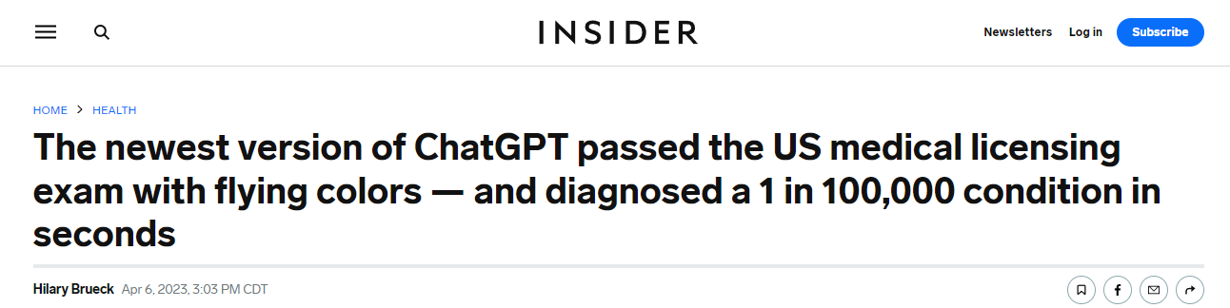

Notes:
https://www.insider.com/chatgpt-passes-medical-exam-diagnoses-rare-condition-2023-4
https://law.stanford.edu/2023/04/19/gpt-4-passes-the-bar-exam-what-that-means-for-artificial-intelligence-tools-in-the-legal-industry/

Slide 6
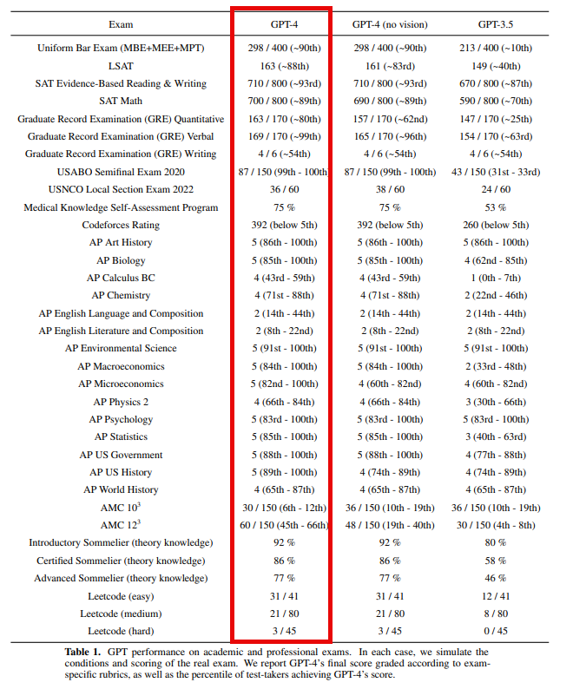
Notes:
https://cdn.openai.com/papers/gpt-4.pdf

Slide 7
Use the website, Get the mobile App
Website - https://chat.openai.com/
Mobile
Android - https://play.google.com/store/apps/details?id=com.openai.chatgpt&hl=en_US&gl=US&pli=1
iPhone - https://apps.apple.com/us/app/chatgpt/id6448311069

Slide 8
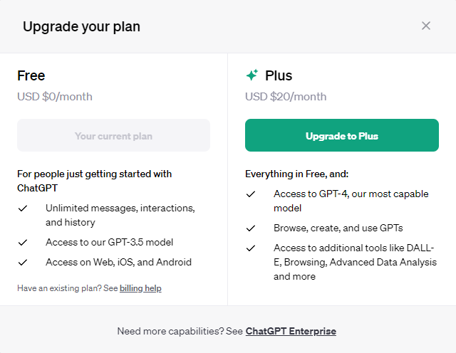
Upgrading

Slide 9
Plugins
Third Party Extravaganza

Slide 10
Which ones are the “best”?
What are you trying to do?
Can it be done already in ChatGPT without a Plugin?
How hard is it to do?
Is there a free Plugin?
How much does the paid Plugin cost?

Slide 11
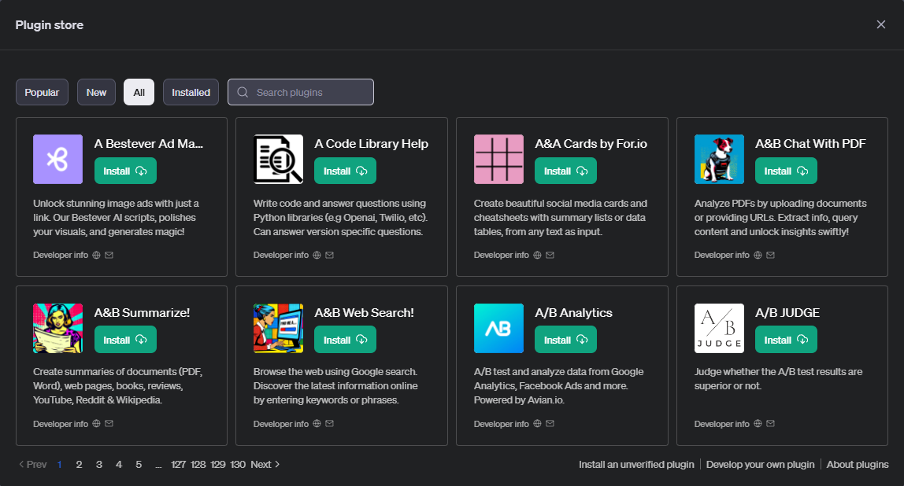
The List is Constantly Changing (About 1,040 on 11/25/2023)

Slide 12
Using the Plugin Store
Finding the Right One for You

Slide 13
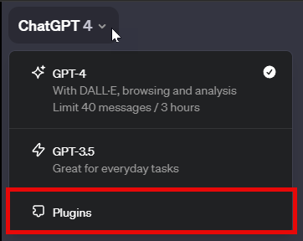
How to get Started

Slide 14

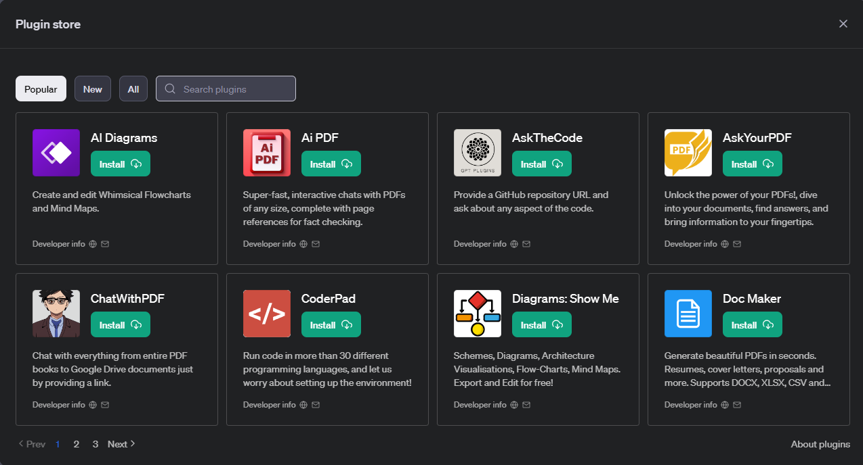
Browsing the Plugin Store

Slide 15


Installing Plugins

Slide 16

Uninstalling Plugins

Slide 17
Using Some Plugins
Some Examples to get you started

Slide 18
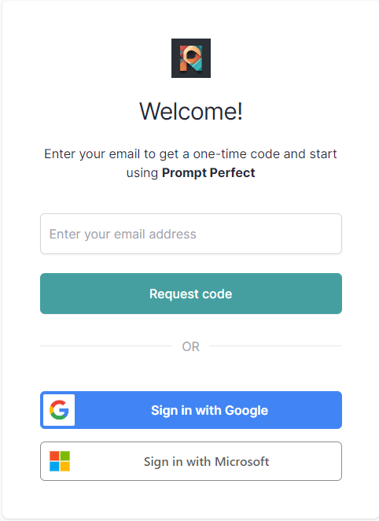
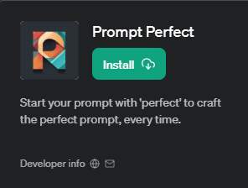
Prompt Perfect

Slide 19
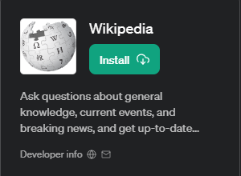
Wikipedia

Slide 20

Diagrams: Show Me

Slide 21
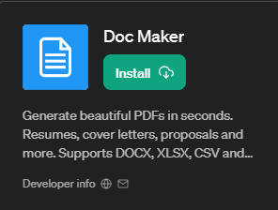
Doc Maker

Slide 22

Smart Slides

Slide 23

Open Table

Slide 24
Plugins for techies
Deeper stuff for the coders

Slide 25

Wolfram Alpha

Slide 26
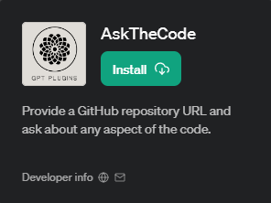
Ask the code

Slide 27
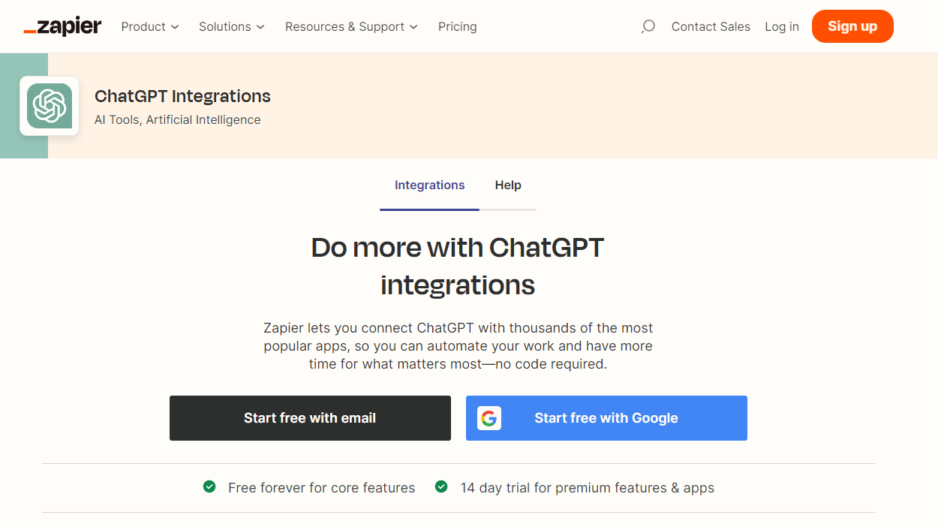
Zapier

Slide 28


